Slide 1
Visual Studio 2010 SharePoint Tools
Notes:
This lecture provides an introduction to the new SharePoint Tools that are included with Visual Studio 2010.

Slide 2
Outline
Introduction to VS2010 SharePoint Tools
SharePoint Tools Project Structure
Adding SPIs to a Project
SharePoint Tools Extensibility

Slide 3
SharePoint 2007 Development
Visual Studio Experience Is Limited
Visual Studio Extensions for WSS
Visual Studio Tools for Office with VS2008
SharePoint developers reliant on community tools
Developers have to deal with tedious details
Manually editing CAML files
Understanding RootFiles directory of WSS
Manual edits to manifest.xml file
Building .wsp file for solution package
Notes:
The developer experience for SharePoint 2007 has been less than ideal due to a lack of tool support, wizards and designers. Many developers coming from a background with .NET and ASP.NET development have been frustrated at the need to write batch files, work in the command line and write XML in a under-documented language know as Collaborative Application Markup Language (CAML).
The functionality of Visual Studio Extensions for WSS 3.0 was much improved as it evolved from version 1.0 to 1.3. Although even the latest version does not provide an end-to-end solution for SharePoint development. Many SharePoint 2007 developers have an arsenal of community tools to accomplish many of the required tasks within SharePoint development.

Slide 4

Visual Studio 2010 SharePoint Tools
End-to-end SharePoint 2010 developer story
SharePoint Explorer for site exploration
SharePoint 2010 project and item templates
Visual designers for core scenarios
Migration path for Visual Studio 2008 for WSS 3.0
Extensible by 3rd party developers
Benefits to SharePoint developers
Abstracts away details of RootFiles directory
Abstracts away details of building .wsp file
Lessens/eliminates need for external utilities
Notes:
The Visual Studio 2010 SharePoint Tools (SPT) represents a significant step forward for professional developers using SharePoint.
SharePoint Explorer fallows quick exploration through a site
This makes it possible to launch browser at specific place within site
SharePoint 2010 introduce a new project structure as well as project tmplates and project item templates. There are designers to create things like features and solution packages.
One of the most appealing aspects of SPT is that it is extensible
You can add your own custom project templates and item templates
You can add menu commands into the Visual Studio UI.

Slide 5
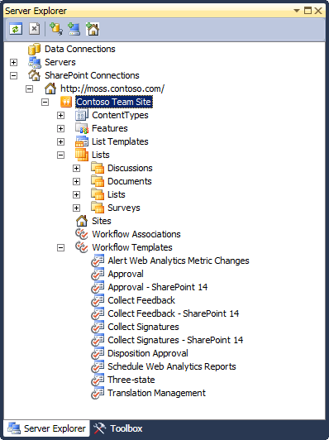
SharePoint Explorer
Add-in for Server Explorer window
Easy way to examine site artifacts
Quick way to launch browser into site
SharePoint Explorer extensibility
Developers can write add-ins to populate nodes and provide contextual menu commands
Notes:
The SharePoint Explorer is a simple easy-to-use tools.
It provides a read-only treeview of a SharePoint site.
Note that SharePoint Explorer only works on sites that are running locally

Slide 6
SharePoint Explorer
demo
Notes:
Simple on minute demo.
Create a new team site in Central admin
Go to Visual Studio and connect SharePoint Explorer to new site
Show what lists already exist within site.
Click on list to bootstrap browser into site at list’s default view

Slide 7
Outline
Introduction to VS2010 SharePoint Tools
SharePoint Tools Project Structure
Adding SPIs to a Project
SharePoint Tools Extensibility

Slide 8
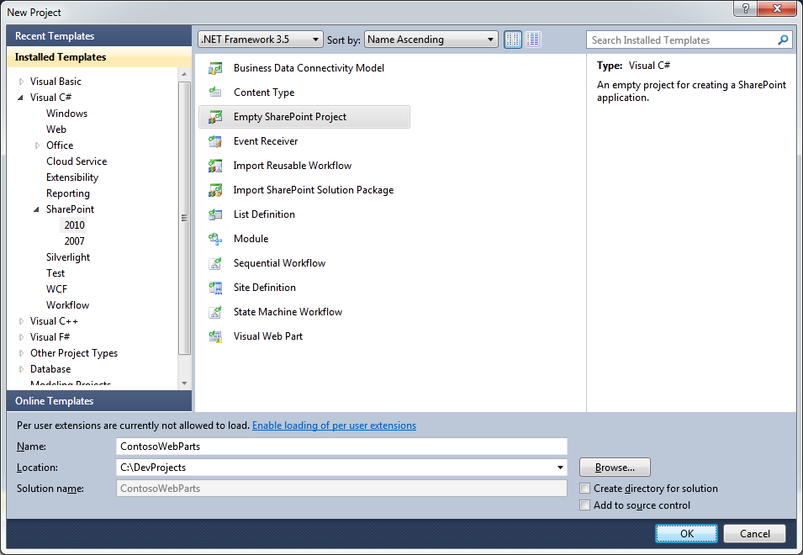
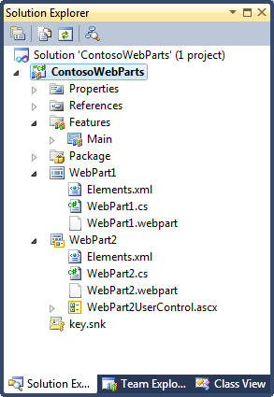
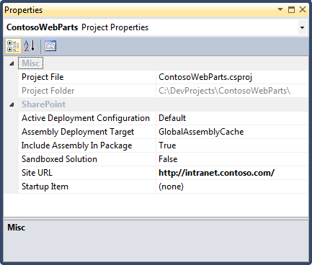
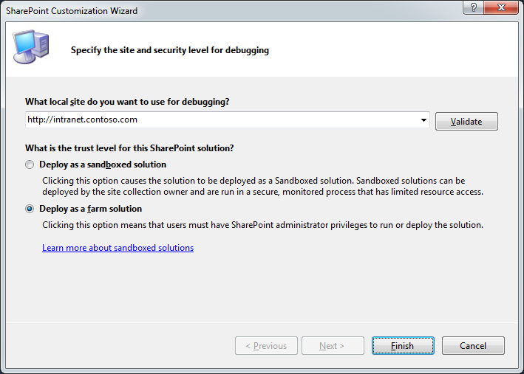
SharePoint 2010 Project Templates
SharePoint Projects have standard properties
Project File
Project Folder
Active Deployment Configuration
Include Assembly in Package
Assembly Deployment Target
Sandboxed Solution
Site URL
Startup Item

Slide 9

SharePoint 2010 Project Structure
Standard Project Nodes
Properties (standard with all Visual Studio projects)
References (standard with all Visual Studio projects)
Features (added by SharePoint Tools)
Package (added by SharePoint Tools)
SharePoint Project Items (added using SharePoint Tools Project Item Templates)

Slide 10
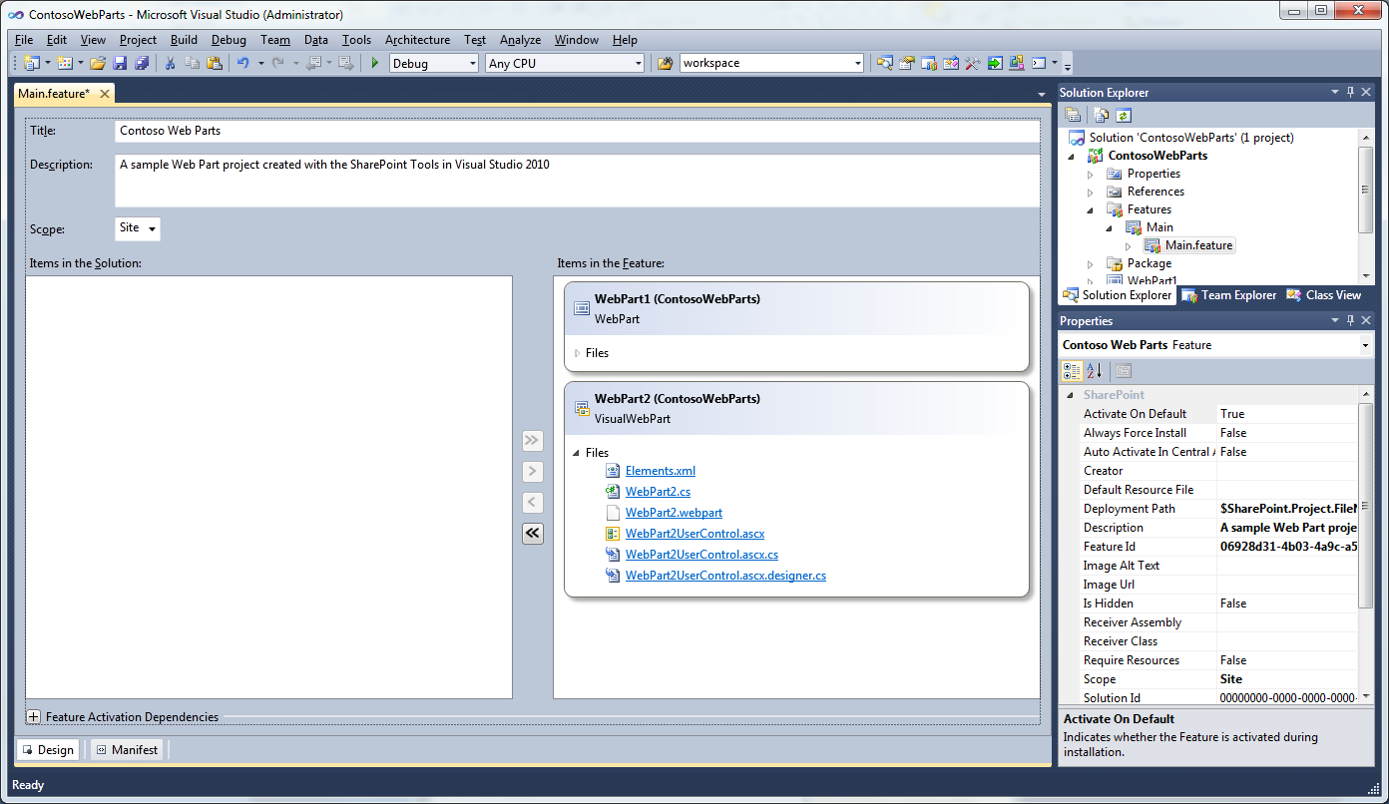
Feature Node and Feature Designer
Feature node contains one or more features
Feature designer provides design mode and XML text Mode
Customize feature properties in designer and/or property grid
Use Context menu of Feature node to add feature event receiver
Feature designer allows adding/removing SPIs
Customize feature activation dependencies

Slide 11
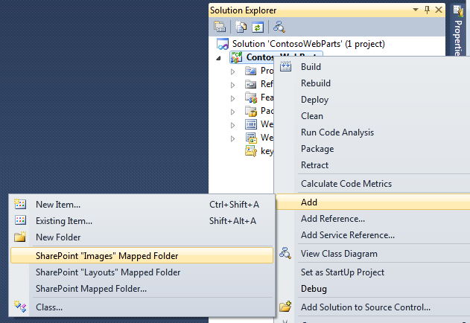
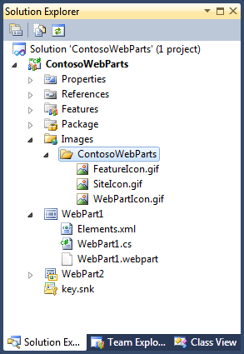
Mapped Folders
Mapped Folders used to deploy to RootFiles
Layouts folder maps to virtual path /_layouts
Images folder maps to virtual path /_layouts
You can map other folders inside RootFiles directory
Layouts folder key to creating application pages
Best practice to create solution-specific folder inside Layouts

Slide 12
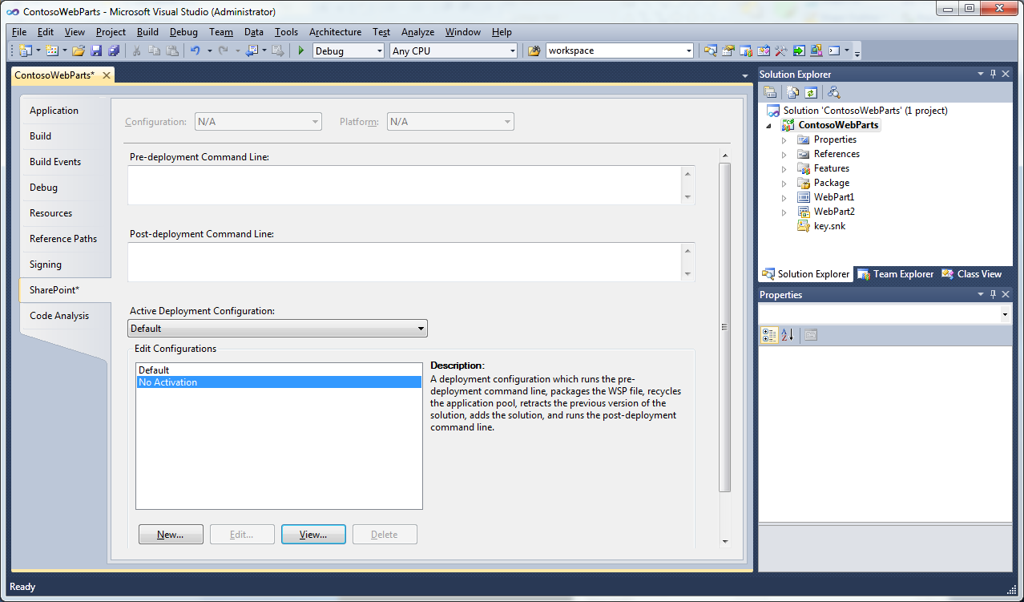
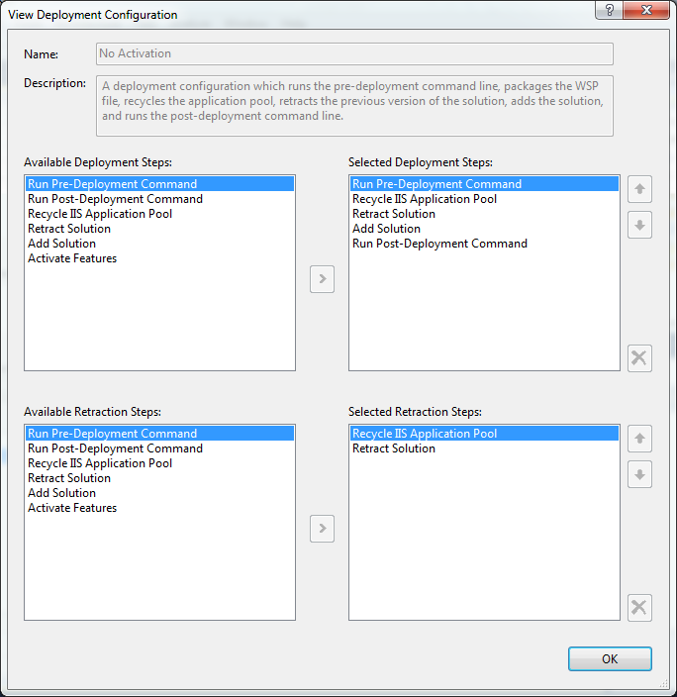
SPT Deployment Options
Two Deployment configuration by default
Default
No Activation

Slide 13
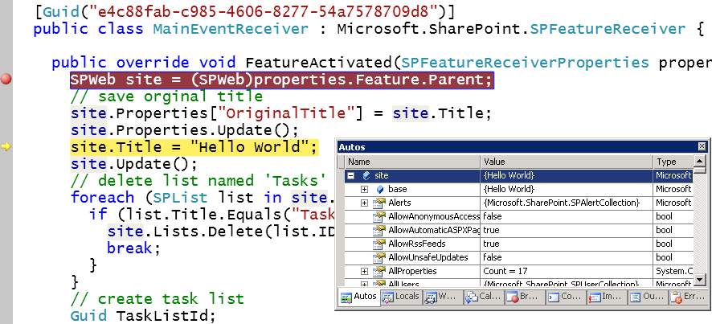
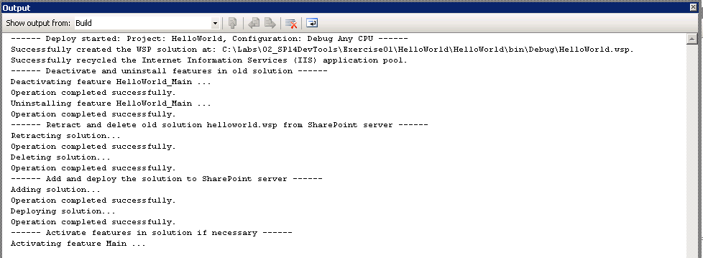
The F5 Debugging Experience
What does F5 do?
Builds new version of .wsp file
Deactivates/uninstalls feature
Retracts/deletes old .wsp file
Adds/deploys new .wsp file
Activates feature in target site (via Site Url)
Attaches debugger to W3WP.EXE worker process (via Site URL)

Slide 14
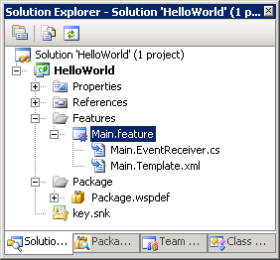
Hello World with VS 2010 SharePoint Tools
demo

Slide 15
Outline
Introduction to VS2010 SharePoint Tools
SharePoint Tools Project Structure
Adding SPIs to a Project
SharePoint Tools Extensibility

Slide 16
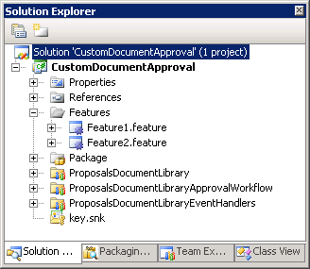
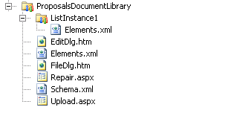


SharePoint Project Items (SPIs)
Projects built with SharePoint Items (SPIs)
SPI is a logical collection of project files Examples of SPIs are WebParts, List Defs, Workflows, etc
Each SPI has folder with SPI files
Compilation & deployment details abstracted away through SPI file properties

Slide 17
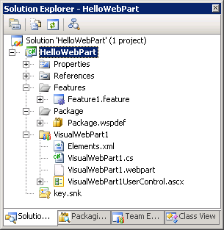




SPI File Properties
Project tracks properties for each SPI File
Visual Studio properties for compilation
SharePoint 2010 properties for deployment

Slide 18
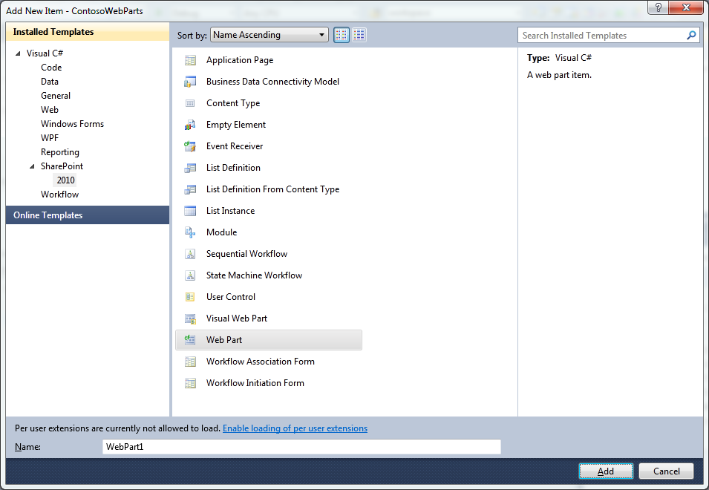
SharePoint Project Item Templates

Slide 19
MetroWebParts
demo
Notes:
Create an empty project
Add VisualWebPart project item
Add ApplicationPage project item
Create mapped Images directory and add image

Slide 20
Outline
Introduction to VS2010 SharePoint Tools
SharePoint Tools Project Structure
Adding SPIs to a Project
SharePoint Tools Extensibility

Slide 21
SharePoint 2010 Tools Extensibility
SharePoint 2010 Project system extensibility
Custom extensions integrate into VS10 designer experience
Used to create custom SPIs not supported out-of-box
Much easier than standard VS extensibility model
SPI & Context Menu extensibility
Extend VS context menu for standard and custom SPIs
Provide extensibility to enable access to SP server API
SP Explorer Nodes & Menu extensibility
Create extension to add a node to the SP Explorer
Create extension to enhance existing node

Slide 22
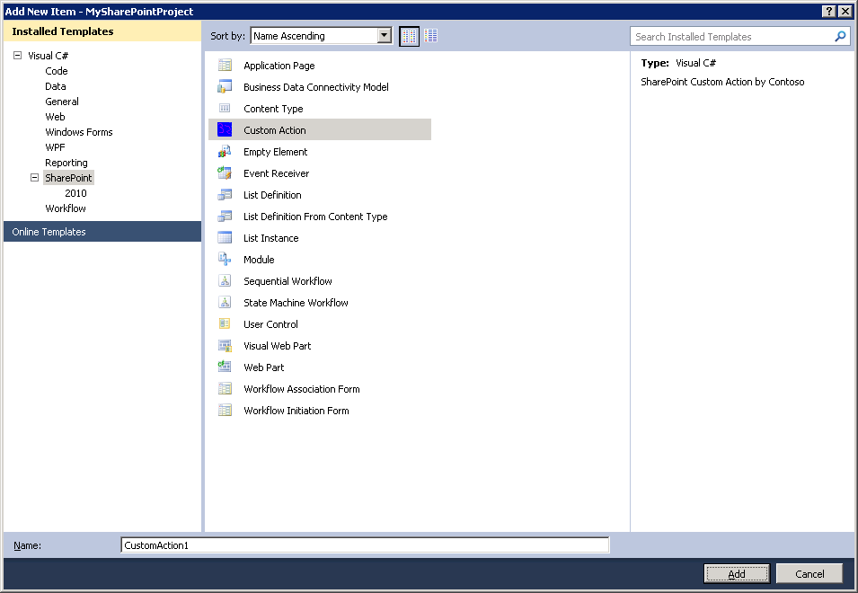
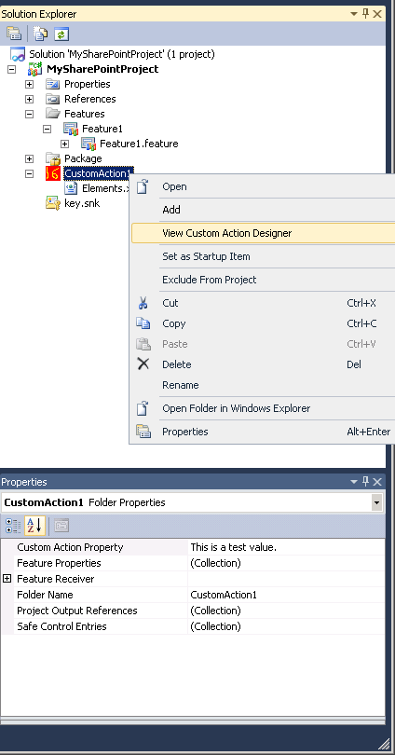
Creating a Custom SPI
Creating a custom SPI Template
Custom SPI is a creatable project item template
Used to add SPI instance to SharePoint projects
You can extend SPI with custom menus and properties
Each SPI instance gets it own folder and can be initialized with a set of files
Custom SPI Template
SPI can be extended with custom menu commands
Custom SPI Template used to add SPI instances to project
SPI can be extended with custom properties

Slide 23
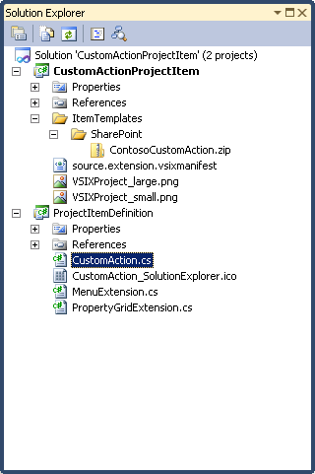
CustomAction
demo

Slide 24
Summary
Introduction to VS2010 SharePoint Tools
SharePoint Tools Project Structure
Adding SPIs to a Project
SharePoint Tools Extensibility

